Slide 1
CHAPTER 6
SORTING
Comparison-based sorting
§1 Preliminaries
void X_Sort ( ElementType A[ ], int N )
/* N must be a legal integer */
/* Assume integer array for the sake of simplicity */
/* ‘>’ and ‘<’ operators exist and are the only operations allowed on the input data */
/* Consider internal sorting only */
The entire sort can be done in main memory
1/4

Slide 2
§2 Insertion Sort
void InsertionSort ( ElementType A[ ], int N )
{
int j, P;
ElementType Tmp;
for ( P = 1; P < N; P++ ) {
Tmp = A[ P ]; /* the next coming card */
for ( j = P; j > 0 && A[ j - 1 ] > Tmp; j-- )
A[ j ] = A[ j - 1 ];
/* shift sorted cards to provide a position
for the new coming card */
A[ j ] = Tmp; /* place the new card at the proper position */
} /* end for-P-loop */
}
The worst case:
Input A[ ] is in reverse order. T( N ) = O( N² )
The best case:
Input A[ ] is in sorted order. T( N ) = O( N )
2/4

Slide 3
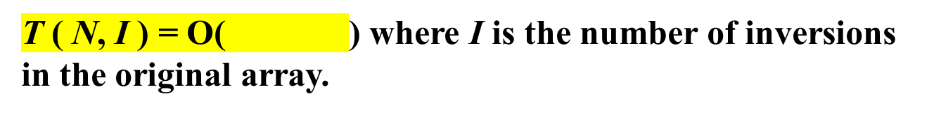
§3 A Lower Bound for Simple Sorting Algorithms
【Definition】An inversion in an array of numbers is any ordered pair ( i, j ) having the property that i < j but A[i] > A[j].
〖Example〗 Input list 34, 8, 64, 51, 32, 21 has inversions.
9
(34, 8) (34, 32) (34, 21) (64, 51) (64, 32) (64, 21) (51, 32) (51, 21) (32, 21)
There are swaps needed to sort this list by insertion sort.
9
Swapping two adjacent elements that are out of place removes exactly one inversion.
I + N
Fast if the list is almost sorted.
3/4

Slide 4
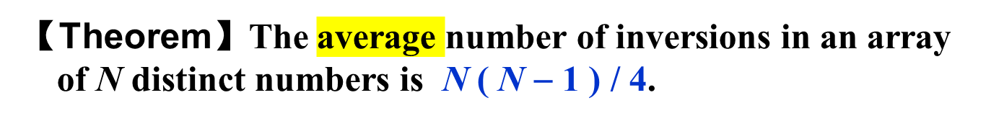
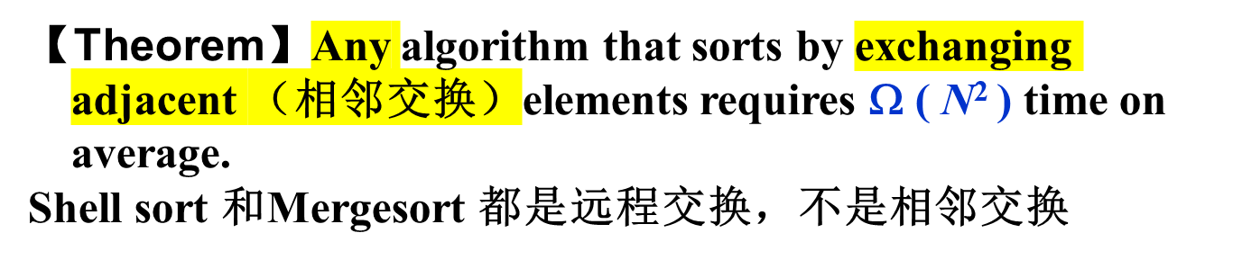






§3 A Lower Bound
For a class of algorithms that performs
only adjacent exchanges, we’ll have to take
O( N² ) time to sort them.
Uhhh… hashing?
Is that all?
How can you speed it up?
Hey! We are talking about
comparison-based sorting.
You must do comparisons, and?
Smart guy! To run faster, we just
have to eliminate more than just
one inversion per exchange.
What does this theorem tell you?
… and swaps elements
that are far apart?
4/4

Slide 5

§4 Shellsort ---- by Donald Shell
〖Example〗Sort:
隔几个取一次
就是insertion sort
81
94
11
96
12
35
17
95
28
58
41
75
15
5-sort
35
17
11
28
12
41
75
15
96
58
81
94
95
3-sort
28
12
11
35
15
41
58
17
94
75
81
96
95
1-sort
11
12
15
17
28
35
41
58
75
81
94
95
96
hk
 Define an increment sequence h₁ < h₂ < … < h_{t} ( h₁ = 1 )
 Define an h_{k}-sort at each phase for k = t, t − 1, …, 1
Note: An h_{k}-sorted file that is then h_{k−1}-sorted remains h_{k}-sorted.
上一轮消除的逆序对下一轮还在
1/10

Slide 6
§4 Shellsort
☞ Shell’s increment sequence:
h_{t} = ⎣ N / 2 ⎦ , h_{k} = ⎣ h_{k+1} / 2 ⎦
void Shellsort( ElementType A[ ], int N )
{
int i, j, Increment;
ElementType Tmp;
for ( Increment = N / 2; Increment > 0; Increment /= 2 )
/*h sequence */
for ( i = Increment; i < N; i++ ) { /* insertion sort */
Tmp = A[ i ];
for ( j = i; j >= Increment; j - = Increment )
if( Tmp < A[ j - Increment ] )
A[ j ] = A[ j - Increment ];
else
break;
A[ j ] = Tmp;
} /* end for-I and for-Increment loops */
}
2/10

Slide 7
§4 Shellsort
☞ Worst-Case Analysis:
【Theorem】The worst-case running time of Shellsort, using Shell’s increments, is Θ ( N² ).
〖Example〗A bad case:
退化成insertion sort
1
9
2
10
3
11
4
12
5
13
6
14
7
15
8
16
8-sort
1
9
2
10
3
11
4
12
5
13
6
14
7
15
8
16
4-sort
1
9
2
10
3
11
4
12
5
13
6
14
7
15
8
16
2-sort
1
9
2
10
3
11
4
12
5
13
6
14
7
15
8
16
1-sort
1
2
3
4
5
6
7
8
9
10
11
12
13
14
15
16
Pairs of increments are not necessarily relatively prime. Thus the smaller increment can have little effect.
不能是上一轮和下一轮整除的，应该是奇数，质数也不一定好
3/10

Slide 8

§4 Shellsort
☞ Hibbard’s Increment Sequence:
h_{k} = 2^{k} − 1 ---- consecutive increments have no common factors.
【Theorem】The worst-case running time of Shellsort, using Hibbard’s increments, is Θ ( N^{3/2} ).
Shellsort is a very simple algorithm, yet with an extremely complex analysis. It is good for sorting up to moderately large input (tens of thousands).
Conjectures:
 T_{avg – Hibbard} ( N ) = O ( N^{5/4} )
 Sedgewick’s best sequence is {1, 5, 19, 41, 109, … } in which the terms are either of the form 9×4^{i} – 9×2^{i} + 1 or
4^{i} – 3×2^{i} + 1. T_{avg} ( N ) = O ( N^{7/6} ) and T_{worst} ( N ) = O ( N^{4/3} ).
sequence是尝试出的不是证明出的
4/10

Slide 9
§5 Heapsort
Algorithm 1:
{
BuildHeap( H );
for ( i=0; i<N; i++ )
TmpH[ i ] = DeleteMin( H );
for ( i=0; i<N; i++ )
H[ i ] = TmpH[ i ];
}
/* O( N ) */
/* O( log N ) */
/* O( 1 ) */
T ( N ) = O ( N log N )
 The space requirement is doubled.
5/10

Slide 10
§5 Heapsort
Algorithm 2:
void Heapsort( ElementType A[ ], int N )
{ int i;
for ( i = N / 2; i >= 0; i - - ) /* BuildHeap */
PercDown( A, i, N );
for ( i = N - 1; i > 0; i - - ) {
Swap( &A[ 0 ], &A[ i ] ); /* DeleteMax */
PercDown( A, 0, i );
}
}
b
d
b
c
a
b
A [0]
a
[1]
d
c
b
a
b
a
c
[2]
c
b
[3]
d
Heapsort data start from position 0.
【Theorem】The average number of comparisons used to heapsort a random permutation of N distinct items is
2N log N − O( N log log N ) .
Note: Although Heapsort gives the best average time, in practice it is slower than a version of Shellsort that uses Sedgewick’s increment sequence.
6/10

Slide 11
§6 Mergesort
1. Merge two sorted lists
Aptr
Aptr
Bptr
Bptr
1
13
24
26
2
15
27
38
1
2
Cptr
Cptr
Cptr
T ( N ) = O ( ) where N is the total number of elements.
N
7/10

Slide 12
2. Mergesort
§6 Mergesort
void MSort( ElementType A[ ], ElementType TmpArray[ ],
int Left, int Right )
{ int Center;
if ( Left < Right ) { /* if there are elements to be sorted */
Center = ( Left + Right ) / 2;
MSort( A, TmpArray, Left, Center ); /* T( N / 2 ) */
MSort( A, TmpArray, Center + 1, Right ); /* T( N / 2 ) */
Merge( A, TmpArray, Left, Center + 1, Right ); /* O( N ) */
}
}
void Mergesort( ElementType A[ ], int N )
{ ElementType *TmpArray; /* need O(N) extra space */
TmpArray = malloc( N * sizeof( ElementType ) );
if ( TmpArray != NULL ) {
MSort( A, TmpArray, 0, N - 1 );
free( TmpArray );
}
else FatalError( "No space for tmp array!!!" );
}
8/10

Slide 13
2. Mergesort
§6 Mergesort
void MSort( ElementType A[ ], ElementType TmpArray[ ],
int Left, int Right )
{ int Center;
if ( Left < Right ) { /* if there are elements to be sorted */
Center = ( Left + Right ) / 2;
MSort( A, TmpArray, Left, Center ); /* T( N / 2 ) */
MSort( A, TmpArray, Center + 1, Right ); /* T( N / 2 ) */
Merge( A, TmpArray, Left, Center + 1, Right ); /* O( N ) */
}
}
void Mergesort( ElementType A[ ], int N )
{ ElementType *TmpArray; /* need O(N) extra space */
TmpArray = malloc( N * sizeof( ElementType ) );
if ( TmpArray != NULL ) {
MSort( A, TmpArray, 0, N - 1 );
free( TmpArray );
}
else FatalError( "No space for tmp array!!!" );
}
If a TmpArray is declared locally for each call of Merge, then S(N) = O( )
N log N
8/10

Slide 14
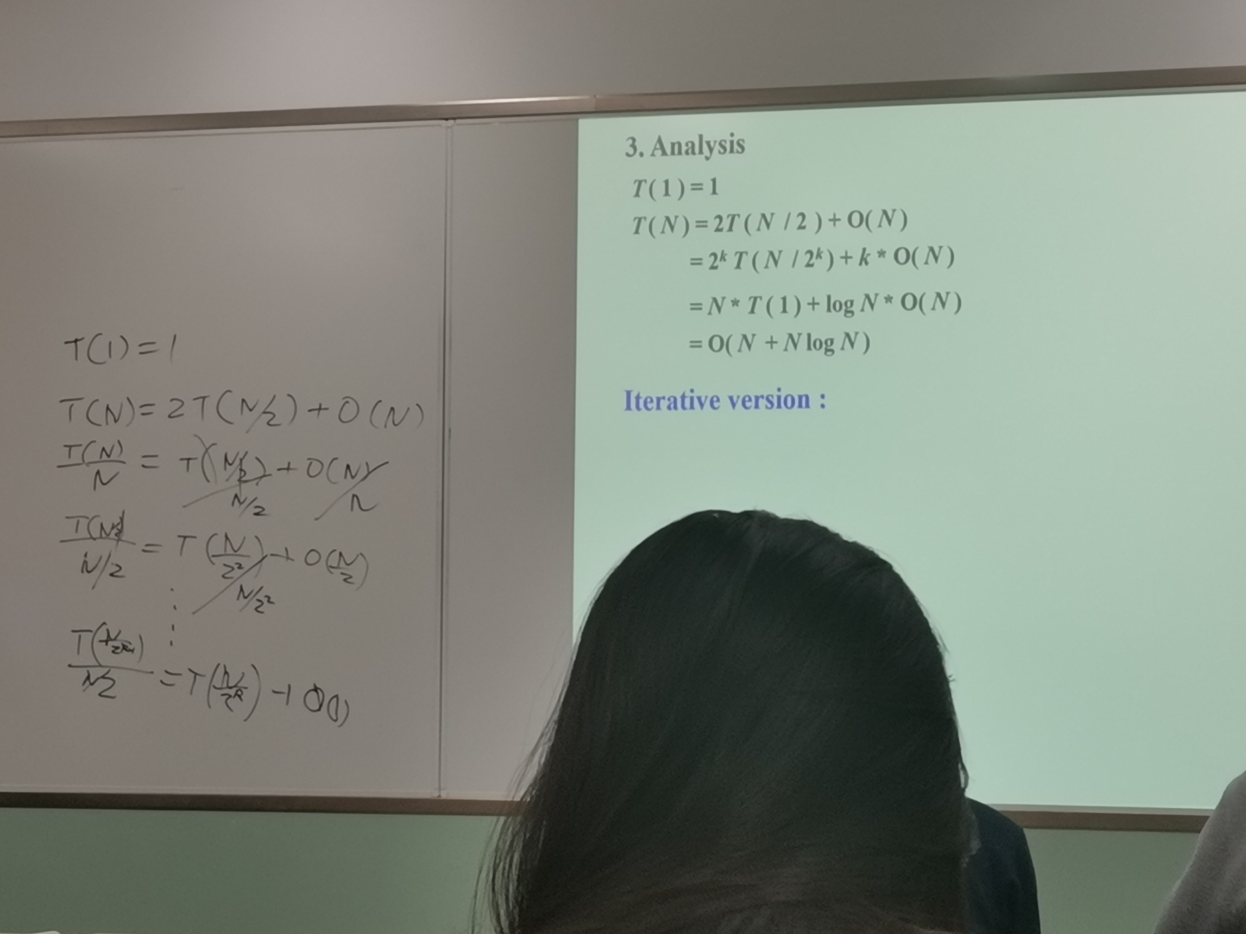

Slide 15
§6 Mergesort
/* Lpos = start of left half, Rpos = start of right half */
void Merge( ElementType A[ ], ElementType TmpArray[ ],
int Lpos, int Rpos, int RightEnd )
{ int i, LeftEnd, NumElements, TmpPos;
LeftEnd = Rpos - 1;
TmpPos = Lpos;
NumElements = RightEnd - Lpos + 1;
while( Lpos <= LeftEnd && Rpos <= RightEnd ) /* main loop */
if ( A[ Lpos ] <= A[ Rpos ] )
TmpArray[ TmpPos++ ] = A[ Lpos++ ];
else
TmpArray[ TmpPos++ ] = A[ Rpos++ ];
while( Lpos <= LeftEnd ) /* Copy rest of first half */
TmpArray[ TmpPos++ ] = A[ Lpos++ ];
while( Rpos <= RightEnd ) /* Copy rest of second half */
TmpArray[ TmpPos++ ] = A[ Rpos++ ];
for( i = 0; i < NumElements; i++, RightEnd - - )
/* Copy TmpArray back */
A[ RightEnd ] = TmpArray[ RightEnd ];
}
9/10

Slide 16
3. Analysis
§6 Mergesort
T ( 1 ) = 1
Note: Mergesort requires linear extra memory, and copying an array is slow. It is hardly ever used for internal sorting, but is quite useful for external sorting.
T ( N ) = 2T ( N / 2 ) + O( N )
= 2^{k} T ( N / 2^{k} ) + k * O( N )
= N * T ( 1 ) + log N * O( N )
= O( N + N log N )
Iterative version :
A
0
1
2
3
…… ……
n−4
n−3
n−2
n−1
…… ……
…… ……
…… …… …… ……
10/10

